Slide 1
DataBase Management System Lab (4CS4-22) Experiment No. -7 7-6-2021(Tuesday) Topic to be covered : Introduction to PL/SQL Data types and Variables

Slide 2
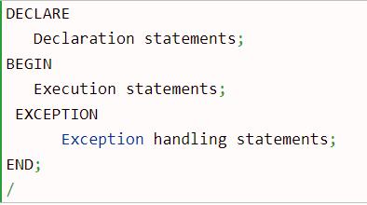
What is PL/SQL:
PL/SQL stands for Procedural Language extension of SQL. It was developed by Oracle Corporation in the late 1980s to enhance the capabilities of SQL. It is the procedural extension language for SQL.
Advantages of PL/SQL:
1. PL/SQL is a procedural language. 2. PL/SQL is a block structure language. 3. PL/SQL handles the exceptions. 4. PL/SQL engine can process the multiple SQL statements simultaneously as a single block hence reduce network traffic and provides better performance.
PL/SQL block structure:

Slide 3
PL/SQL Block sections:
1. Declaration section (optional). 2. Execution section (mandatory). 3. Exception handling section (optional).
Declaration section:
It is an optional section and starts with DECLARE keyword. It is used to declare the variables, constants, records and cursors etc.
Execution section:
Execution section starts with BEGIN keyword and ends with END keyword. It is a mandatory section. It is used to write the program logic code. Note: Execution section must have one statement.
Exception handling section:
Exception section starts with EXCEPTION keyword. It is an optional section. It is used to handle the exceptions occurred in execution section.
Important points:
1. Every PL/SQL statement will be followed by semicolon (;). 2. PL/SQL blocks can be nested.

Slide 4
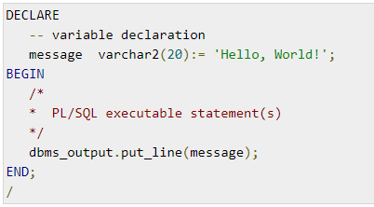
The PL/SQL Comments
Program comments are explanatory statements that can be included in the PL/SQL code that you write and helps anyone reading its source code. All programming languages allow some form of comments.
The PL/SQL supports single-line and multi-line comments. All characters available inside any comment are ignored by the PL/SQL compiler.
The PL/SQL single-line comments start with the delimiter -- (double hyphen) and multi-line comments are enclosed by /* and */.

Slide 5
PL/SQL variables naming rules:
A variable name can’t contain more than 30 characters.
A variable name must start with an ASCII letter followed by any number, underscore (_) or dollar sign ($).
PL/SQL is case-insensitive i.e. var and VAR refer to the same variable.
How to declare variable in PL/SQL:
We have to declare a PL/SQL variable in the declaration section.After declaration PL/SQL allocates memory for the variable and variable name is used to identify the storage location.

Slide 6
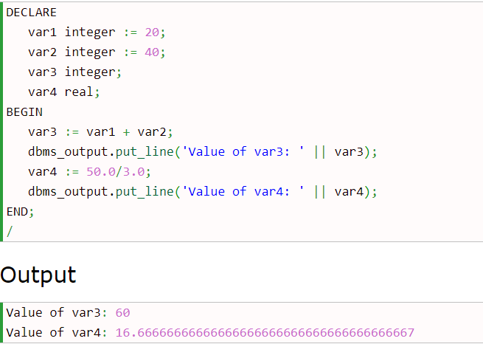
Initializing Variables in PL/SQL:
When we declare a variable PL/SQL assigns it NULL as default value. If we want to initialize a variable with a non-NULL value, we can do it during the declaration. We can use any one of the following methods:
1. The assignment operator Num1 binary_integer := 0;
2. The DEFAULT keyword siteName varchar2(20) DEFAULT ‘w3spoint’;
Example:

Slide 7
Variable Scope in PL/SQL:
PL/SQL allows the nesting of blocks i.e. blocks with blocks. Based on the nesting structure PL/SQL variables can be divide into following categories: Local variables – Those variables which are declared in an inner block and not accessible to outer blocks are known as local variables.
Global variables – Those variables which are declared in the outer block or a package and accessible to itself and inner blocks are known as global variables.

Slide 8
Assigning SQL Query Results to PL/SQL Variables
You can use the SELECT INTO statement of SQL to assign values to PL/SQL variables.
For each item in the SELECT list, there must be a corresponding, type-compatible variable in the INTO list.
The following example illustrates the concept. Let us create a table named CUSTOMERS −
CREATE TABLE CUSTOMERS
( ID INT NOT NULL,
NAME VARCHAR (20) NOT NULL,
AGE INT NOT NULL,
ADDRESS CHAR (25),
SALARY DECIMAL (18, 2),
PRIMARY KEY (ID) );

Slide 9
INSERT INTO CUSTOMERS (ID,NAME,AGE,ADDRESS,SALARY) VALUES
(1, 'Ramesh', 32, 'Ahmedabad', 2000.00 );
DECLARE
c_id customers.id%type := 1; // % type attribute indicator
c_name customers.name%type;
c_addr customers.address%type;
c_sal customers.salary%type;
BEGIN
SELECT name, address, salary INTO c_name, c_addr, c_sal
FROM customers
WHERE id = c_id;
dbms_output.put_line
('Customer ' ||c_name || ' from ' || c_addr || ' earns ' || c_sal);
END;
/
Output:
Customer Ramesh from Ahmedabad earns 2000

Slide 10
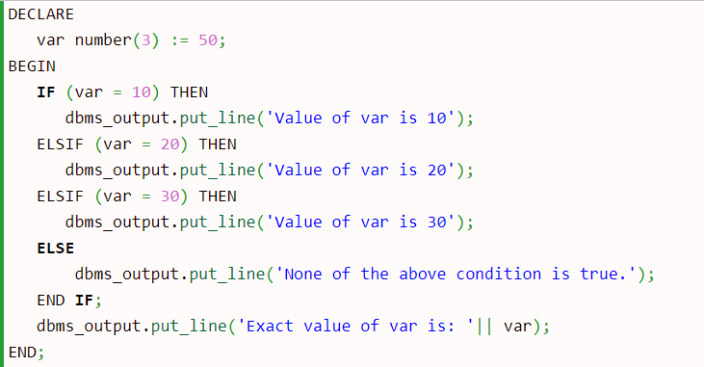
Example of PL/SQL If -else statement

Slide 11
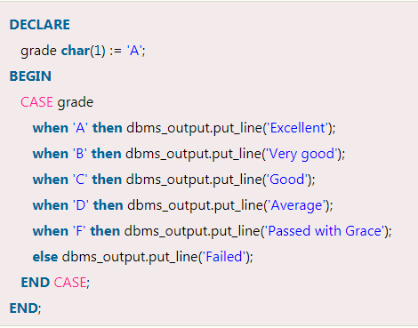
Example of PL/SQL case statement

Slide 12
PL/SQL Loop
The PL/SQL loops are used to repeat the execution of one or more statements for specified number of times. These are also known as iterative control statements.
Syntax for a basic loop:
LOOP
Sequence of statements;
END LOOP;
Types of PL/SQL Loops
There are 4 types of PL/SQL Loops.
Basic Loop / Exit Loop
While Loop
For Loop
Cursor For Loop

Slide 13
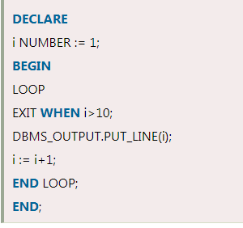
Note: You must follow these steps while using PL/SQL Exit Loop.
Initialize a variable before the loop body
Increment the variable in the loop.
You should use EXIT WHEN statement to exit from the Loop. Otherwise the EXIT statement without WHEN condition, the statements in the Loop is executed only once.

Slide 14
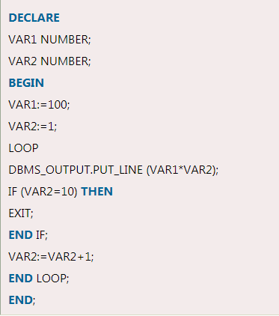

Slide 15
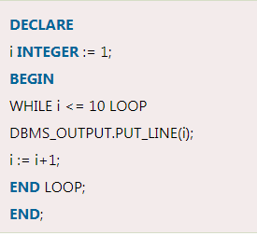
PL/SQL While Loop
PL/SQL while loop is used when a set of statements has to be executed as long as a condition is true, the While loop is used. The condition is decided at the beginning of each iteration and continues until the condition becomes false.
Syntax of while loop:
WHILE <condition>
LOOP statements;
END LOOP;

Slide 16
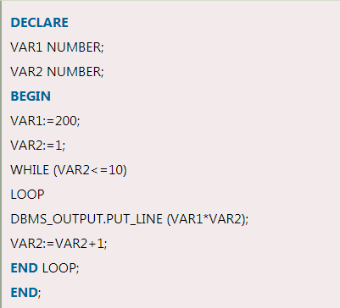
Note: You must follow these steps while using PL/SQL WHILE Loop.
Initialize a variable before the loop body.
Increment the variable in the loop.
You can use EXIT WHEN statements and EXIT statements in While loop but it is not done often.

